Slide 1
PRESENTATION ON L1: MODULE1

Slide 2
contents
Relational Databases & SQL
Test Driven Development
How cloud computing helps business ?
How analytics help businesses ?
OWASP Top Ten
SQL Analysis Task
The Twelve-Factors App
Agile Manifesto

Slide 3
Relational Databases
A relational database is a type of database. It uses a structure that allows us to identify and access data in relation to another piece of data in the database. Often, data in a relational database is organized into tables.
Relational Database Components
Table: A table is a structured set of data organized in rows and columns.
Schema: A database schema defines the structure and organization of data within a database.
Record: In a relational database, each row in the table is a record with a unique ID called the key.
Domain: Domain is a term used in relational database management systems (RDBMS) to describe the data type and constraints of a column in a table
Key: A key is a field or a set of fields in a database table that uniquely identifies each record.

Slide 4
Relational KEys
Keys are one of the basic requirements of a relational database model. It is widely used to identify the tuples(rows) uniquely in the table.
Different Types of Database Keys:
Super Key
Candidate Key
Primary Key
Alternate Key
Foreign Key
Composite Key

Slide 5
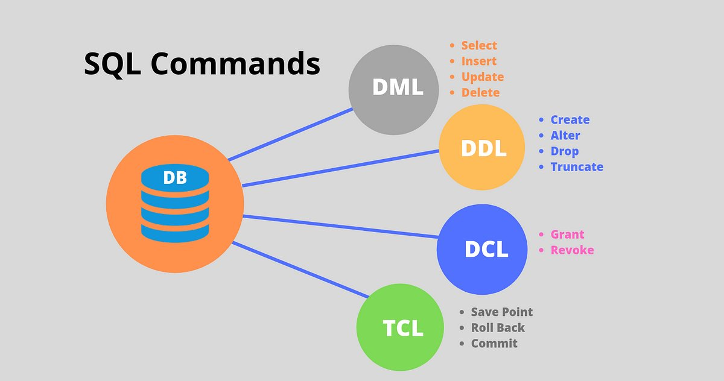
sql
SQL (Structured Query Language) is a programming language used to communicate with data stored in a relational database management system. SQL syntax is similar to the English language, which makes it relatively easy to write, read, and interpret.

Slide 6
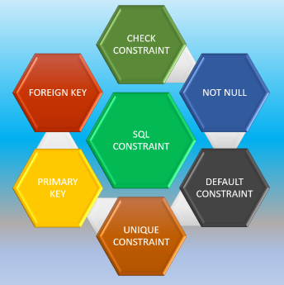
Constraints in SQL
Constraints are used to limit the type of data that can go into a table. This ensures the accuracy and reliability of the data in the table. If there is any violation between the constraint and the data action, the action is aborted.
The CHECK Constraint enables a condition to check the value being entered into a record.
The NOT NULL constraint enforces a column to NOT accept NULL values.
The DEFAULT constraint is used to set a default value for a column.
The UNIQUE Constraint do not allow two records from having identical values in a column.
A Primary key must contain unique values. A primary key column cannot have NULL values.
A Foreign key is a key used to link two tables together. This is also called a referencing key.

Slide 7
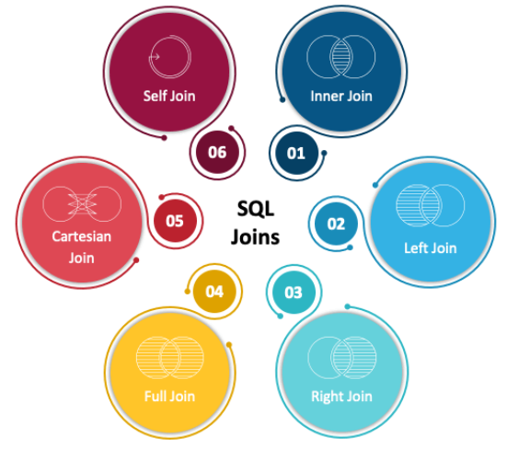
Joins
SQL joins are the foundation of database management systems, enabling the combination of data from multiple tables based on relationships between columns.
SYNTAX EXAMPLES:
Syntax for Inner Join
SELECT table1.column1,table1.column2,table2.column1,.... FROM table1 INNER JOIN table2 ON table1.matching_column = table2.matching_column;
Syntax for Left Join
SELECT table1.column1,table1.column2,table2.column1,.... FROM table1 LEFT JOIN table2 ON table1.matching_column = table2.matching_column;

Slide 8
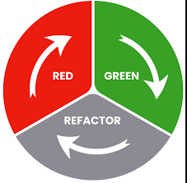

Test-Driven Development
Test-driven development (TDD) is an established technique for sustainably delivering better software faster. TDD is based on a simple idea: write a failing test before you write production code itself.
TDD is really a technique for design. The foundations of TDD are focused on using small tests to design systems from the ground up in an emergent manner, and to rapidly get value while building confidence in the system. A better name for this technique might really be Test-Driven Design.
Any software while creating must be tested to ensure it meets the functional requirements, but also test non-functional requirements, like security, usability, critically maintainability.
TDD has two different approaches Inside-out and Outside-In.
Certain TDD Advantages
Write better software.
Avoid over-engineering.
Have protection from breaking the world when introducing new features.
Software is self-documented.

Slide 9
cloud computing
Cloud Computing is the one-demand delivery of software/hardware components via network (usually internet).
How cloud computing helps business ?
Efficiency and Cost Reduction
High Speed-Quick Deployment
Scalability
Unlimited Storage Capacity
Data Security
Back-up and Restore Data
Disaster Recovery
Mobility

Slide 10
How analytics help businesses ?
Data analytics is the process of storing, organizing, and analyzing raw data to answer questions or gain important insights. Data analytics is integral to business because it allows leadership to create evidence-based strategy, understand customers to better target marketing initiatives, and increase overall productivity.
Gain greater insight into target markets
Enhance decision-making capabilities
Create targeted strategies and marketing campaigns
Improve operational inefficiencies and minimize risk
Identify new product and service opportunities

Slide 11
OWASP TOP 10
Worldwide not-for-profit organization founded in 2001.
Globally recognized by developers as the first step towards more secure coding.
The OWASP (Open Web Application Security Project) Top 10 is a standard awareness document for developers and web application security. It represents a broad consensus about the most critical security risks to web applications.

Slide 12
OWASP TOP-10 2021
A01:2021-Broken Access Control:
Allowing users to access the information they are not truly authorized to access.
Prevention: Employ threat modeling for critical access control, authentication, key flows .
A02:2021-Cryptographic Failures:
Poorly implementation of cryptographic protocols.
Prevention: Encrypt your data in transit as well as at rest and Implement only the most updated encryption techniques.
A03:2021-Injection:
Insertion of malicious data into an application or via APIs.
Prevention: Use a safe API to eliminate the interpreter.
A04:2021-Insecure Design:
They are caused by an insecure design that does not include threat modeling, secure design principles and patterns.
Prevention: Set up and enforce a lifecycle that includes security in the design of the software and all development phases.
A05:2021-Security Misconfiguration:
Security misconfigurations occur when issues in the application configurations allow unauthorized access, usage, modification.
Prevention: Set up a patch management process includes configuration reviews followed by updates and fixes.

Slide 13
A06:2021-Vulnerable and Outdated Components:
This category refers to unsupported, out-of-date, and vulnerable software components.
Prevention: Avoid using vulnerable and outdated components such as unused dependencies and any unnecessary features.
A07:2021-Identification and Authentication Failures:
This category includes vulnerabilities caused by identification and authentication failures.
Prevention: Implement MFA and enforce strong passwords.
A08:2021-Software and Data Integrity Failures:
Includes assumptions made regarding software updates, CI/CD pipelines, and critical data without verifying integrity.
Prevention: Avoid integrity failures via Digital Signatures and trusted repositories.
A09:2021-Security Logging and Monitoring Failures:
Includes vulnerabilities related to security monitoring and logging failures.
Prevention: Prevent failures uses context, encoding, formatting.
A10:2021-Server-Side Request Forgery:
Occurs when a web application fetches remote resources without validating user-supplied URLs.
Prevention: Always validate and sanitize client-supplied input data.

Slide 14
SQL analysis task
Access Link for create.sql file, qeries.sql file and ER Diagram.
Link for Task Files
Or follow the url: https://goto.now/0nZUZ

Slide 15
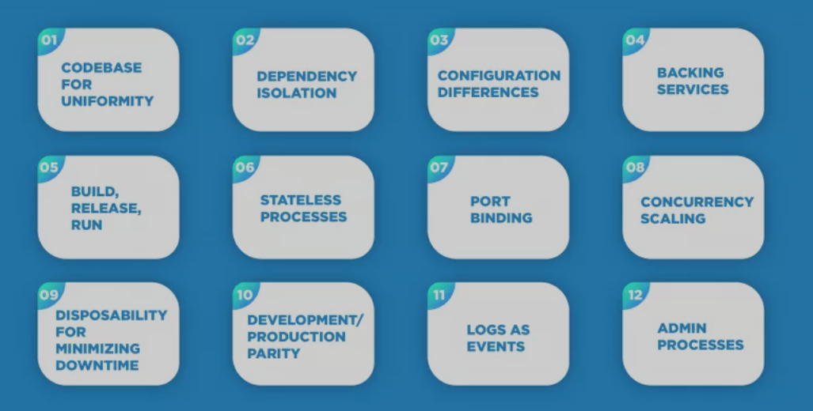
THE twelve-Factor app
The Twelve-Factor App methodology is a methodology for building software-as-a-service applications. These best practices are designed to enable applications to be built with portability and resilience when deployed to the web

Slide 16
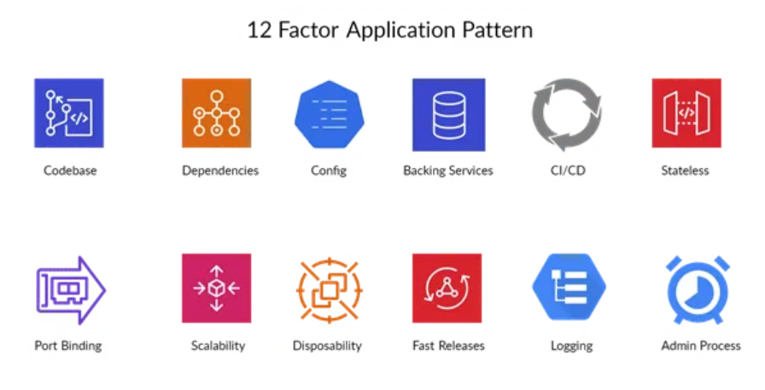
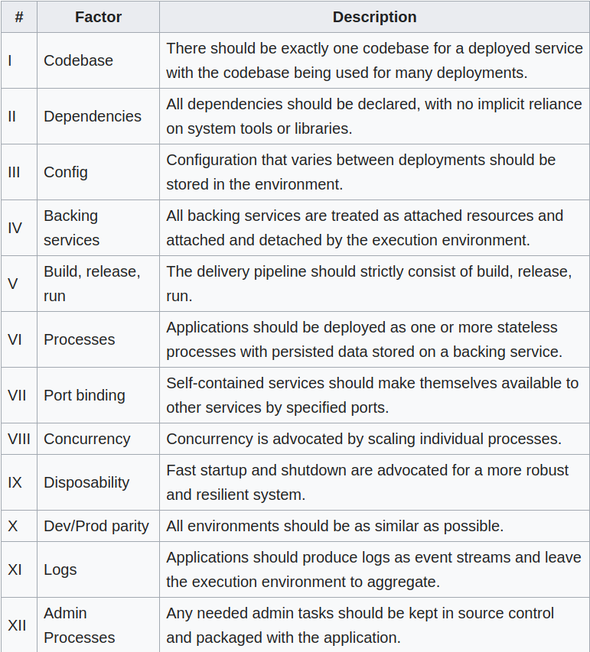

Slide 17
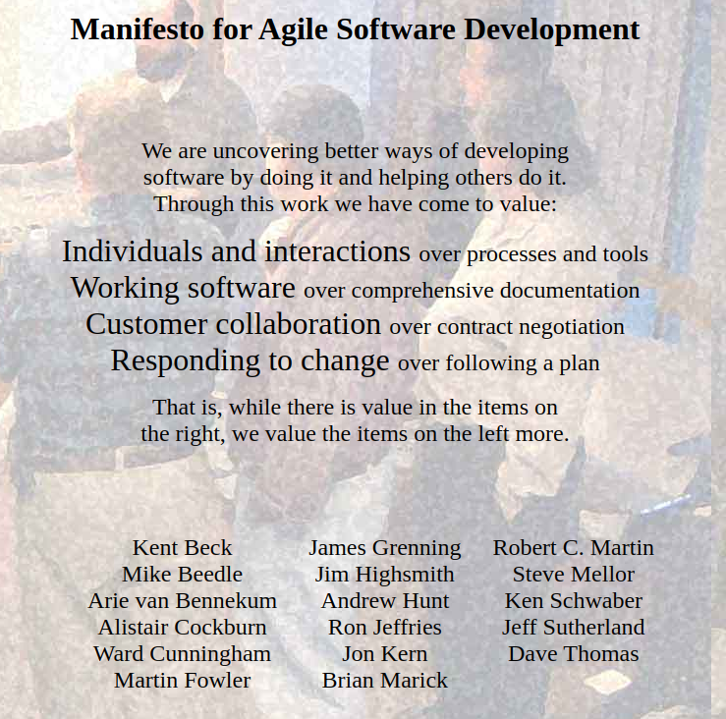
Agile Manifesto
The Agile Manifesto is a document that identifies four key values and 12 principles that its authors believe software developers should use to guide their work. Formally called the Manifesto for Agile Software Development​.
​
The developers called themselves the Agile Alliance. They were seeking an alternative to the existing software development processes that they saw as complicated, unresponsive and too focused on documentation requirements.​

Slide 18
AGILE Manifesto 12 Principles
Our highest priority is to satisfy the customer through the early and continuous delivery of valuable software.
Welcome changing requirements, even late in development. Agile processes harness change for the customer’s competitive advantage.
Deliver working software frequently, from a couple of weeks to a couple of months, with a preference to the shorter timescale.
Business people and developers must work together daily throughout the project.
Build projects around motivated individuals. Give them the environment and support they need and trust them to get the job done.
The most efficient and effective method of conveying information to and within a development team is face-to-face conversation.
Working software is the primary measure of progress
Agile processes promote sustainable development. The sponsors, developers, and users should be able to maintain a constant pace indefinitely.
Continuous attention to technical excellence and good design enhances agility.
Simplicity–the art of maximizing the amount of work not done–is essential.
The best architectures, requirements, and designs emerge from self-organizing teams.
At regular intervals, the team reflects on how to become more effective, then tunes and adjusts its behaviour accordingly.

Slide 19
Lovepreet Singh
XS0905
love@xenonstack.com

